Slide 1

Simulation of a 3 level Laser System & Calculation of the Output power of a Laser
4 de janeiro de 2023
André Fernandes, Nº: 97977
Gonçalo Freitas, Nº 98012
Seminário Engenharia Computacional, Conteúdo C – Física
2022-23
Docentes: Carlos Brites (carlos.brites@ua.pt)
Albano Neto (albanoneto@ua.pt)

Slide 2
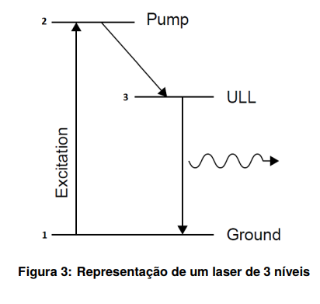

3 LEVEL LASER SYSTEM
Pumping Rate - $φ$
Absorption Cross-Section
$σ ={10}^{−17} [cm2 ]$
Power Density
$Pd = 20 [W/cm2 ] = 20 ×{10}^{7}[erg/(s · cm2 )]$
Excitation Wavelength
$λ_{exc} = 600 [nm] = 600 ×{10}^{−7}[cm]$
Planck’s Constant
$h = 6.62 ×{10}^{−27} [erg · s]$
2→ 3 rate
$W_{2→3}$= ${10}^{7}$ [$s^{−1}$]
Laser Decay Lifetime
$τ = 1.5 ×{10}^{−3} [s]$
Speed of Light in Vacuum
$c = 299792458 × {10}^{2}$ [𝑐𝑚/𝑠]
1 – LLL (lower lasing level)
2 – Excitation Level
3 – ULL (upper lasing level)

Slide 3
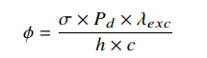
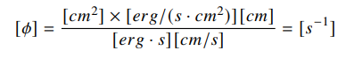

3 LEVEL LASER SYSTEM
$σ ={10}^{−17} [cm2 ]$
$Pd = 20 [W/cm2 ] = 20 ×{10}^{7}[erg/(s · cm2 )]$
$λ_{exc} = 600 [nm] = 600 ×{10}^{−7}[cm]$
$h = 6.62 ×{10}^{−27} [erg · s]$
$c = 299792458 × {10}^{2}$ [𝑐𝑚/𝑠]
1 – LLL (lower lasing level)
2 – Excitation Level
3 – ULL (upper lasing level)
$φ=604.6479$ [$s^{−1}$]

Slide 4



Rate EQUATIONS
$$\frac{dN_{1}}{dt}=−φ ×N_{1}+\frac{N_{3}}{τ}$$
$$\frac{dN_{2}}{dt}=φ ×N_{1}−N_{2}×W_{23}$$
$$\frac{dN_{3}}{dt}=N_{2}×W_{23}−\frac{N_{3}}{τ}$$
1 – LLL (lower lasing level)
2 – Excitation Level
3 – ULL (upper lasing level)

Slide 5




Rate EQUATIONS
$$\frac{dN_{1}}{dt}=−φ ×N_{1}+\frac{N_{3}}{τ}$$
$$\frac{dN_{2}}{dt}=φ ×N_{1}−N_{2}×W_{23}$$
$$\frac{dN_{3}}{dt}=N_{2}×W_{23}−\frac{N_{3}}{τ}$$
Closing condition: Everything that is input at one level appears as output at another level
1 – LLL (lower lasing level)
2 – Excitation Level
3 – ULL (upper lasing level)

Slide 6







Population Inversion
$$\frac{dN_{1}}{dt}=−φ ×N_{1}+\frac{N_{3}}{τ}$$
$$0=−φ ×N_{1}+\frac{N_{3}}{τ}$$
$$\frac{dN_{2}}{dt}=φ ×N_{1}−N_{2}×W_{23}$$
$$0=φ ×N_{1}−N_{2}×W_{23}$$
$$0=N_{2}×W_{23}−\frac{N_{3}}{τ}$$
Steady State
$$\frac{dN_{3}}{dt}=N_{2}×W_{23}−\frac{N_{3}}{τ}$$
$$\frac{dN}{dt}=0$$

Slide 7


Population Inversion
$$\frac{dN_{1}}{dt}=−φ ×N_{1}+\frac{N_{3}}{τ}$$
$$0=−φ ×N_{1}+\frac{N_{3}}{τ}$$
$$\frac{dN_{2}}{dt}=φ ×N_{1}−N_{2}×W_{23}$$
$$0=φ ×N_{1}−N_{2}×W_{23}$$
$$0=N_{2}×W_{23}−\frac{N_{3}}{τ}$$
Steady State
$$\frac{dN_{3}}{dt}=N_{2}×W_{23}−\frac{N_{3}}{τ}$$
$$\frac{dN}{dt}=0$$

Slide 8
Population Inversion
$$\frac{dN_{1}}{dt}=−φ ×N_{1}+\frac{N_{3}}{τ}$$
$$0=−φ ×N_{1}+\frac{N_{3}}{τ}$$
$$\frac{dN_{2}}{dt}=φ ×N_{1}−N_{2}×W_{23}$$
$$0=φ ×N_{1}−N_{2}×W_{23}$$
$$0=N_{2}×W_{23}−\frac{N_{3}}{τ}$$
Steady State
$$\frac{dN_{3}}{dt}=N_{2}×W_{23}−\frac{N_{3}}{τ}$$
$$\frac{dN}{dt}=0$$
$$N_{3}=N_{1}(φ × τ )$$

Slide 9
Population Inversion
$$\frac{dN_{1}}{dt}=−φ ×N_{1}+\frac{N_{3}}{τ}$$
$$0=−φ ×N_{1}+\frac{N_{3}}{τ}$$
$$\frac{dN_{2}}{dt}=φ ×N_{1}−N_{2}×W_{23}$$
$$0=φ ×N_{1}−N_{2}×W_{23}$$
$$0=N_{2}×W_{23}−\frac{N_{3}}{τ}$$
Steady State
$$\frac{dN_{3}}{dt}=N_{2}×W_{23}−\frac{N_{3}}{τ}$$
$$\frac{dN}{dt}=0$$
$$ΔN =N_{3}−N_{1}=N_{1}(φ × τ − 1)$$
$$N_{3}=N_{1}(φ × τ )$$

Slide 10
Population Inversion
$$\frac{dN_{1}}{dt}=−φ ×N_{1}+\frac{N_{3}}{τ}$$
$$0=−φ ×N_{1}+\frac{N_{3}}{τ}$$
$$\frac{dN_{2}}{dt}=φ ×N_{1}−N_{2}×W_{23}$$
$$0=φ ×N_{1}−N_{2}×W_{23}$$
$$0=N_{2}×W_{23}−\frac{N_{3}}{τ}$$
Steady State
$$\frac{dN_{3}}{dt}=N_{2}×W_{23}−\frac{N_{3}}{τ}$$
$$\frac{dN}{dt}=0$$
$$ΔN =N_{3}−N_{1}=N_{1}(φ × τ − 1)$$
$$N_{3}=N_{1}(φ × τ )$$
$$ΔN>0 →N_{3}−N_{1} →φ × τ>1$$

Slide 11
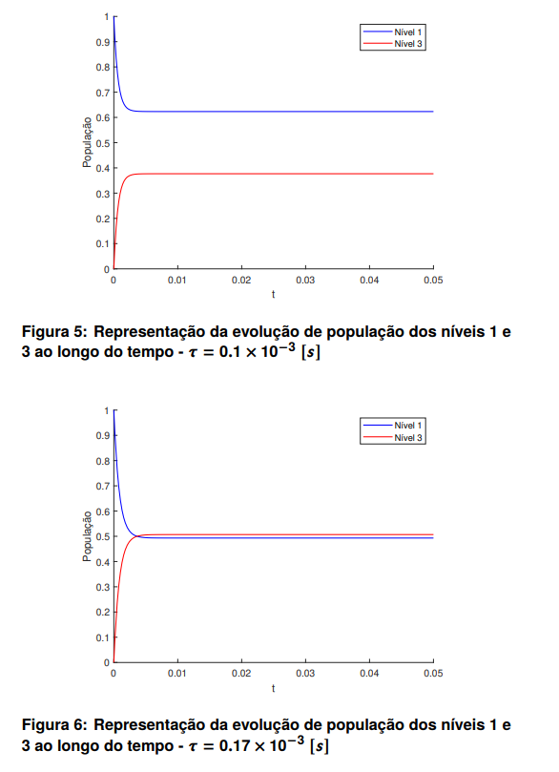
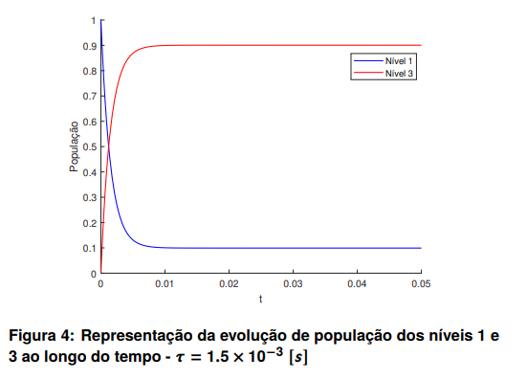
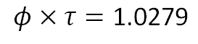
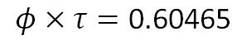
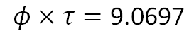
Population Inversion
$$φ×τ=\text{0.60465}$$
$$φ×τ=\text{9.0697}$$
$$φ×τ=\text{1.0279}$$

Slide 12
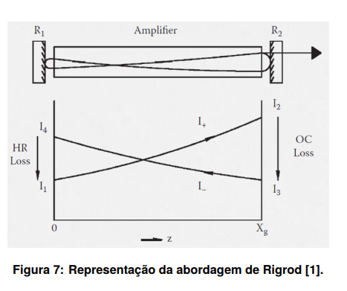
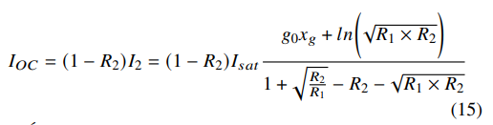
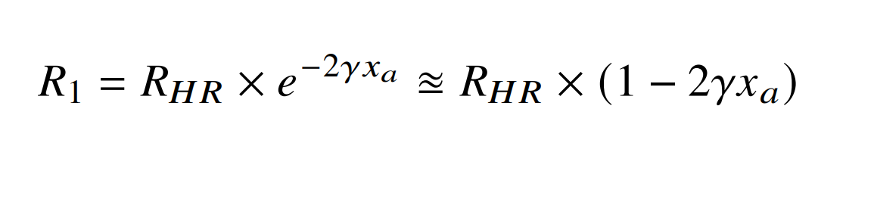
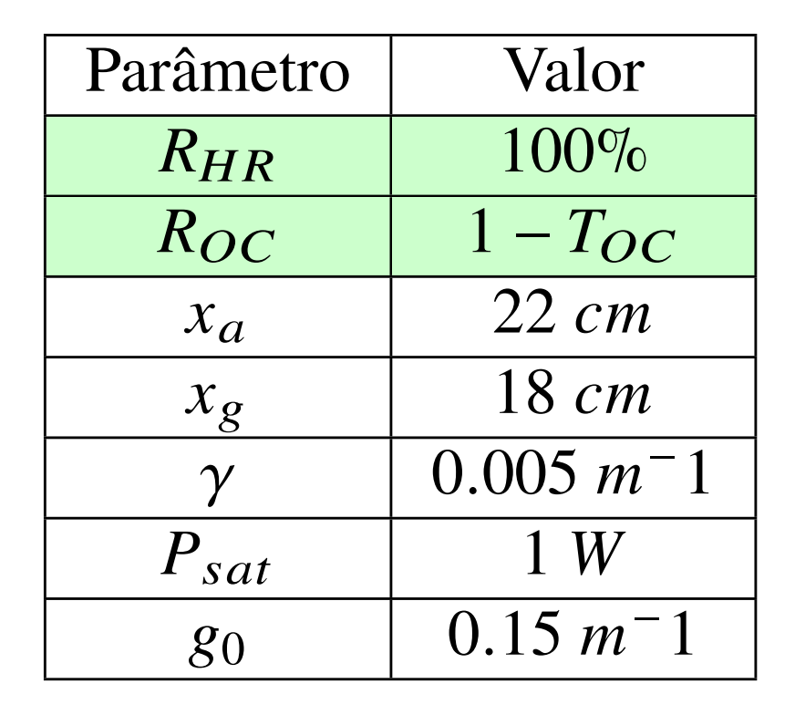
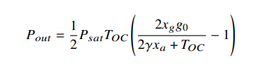

Calculation of the Output Power of a Laser
Rigrod analytical solution (low loss and low gain laser) :
Optimal Output Coupling ( Transmisson in R2, i.e, $T_{OC} < 10\%$) :
Example Parameters for an He-Ne laser

Slide 13
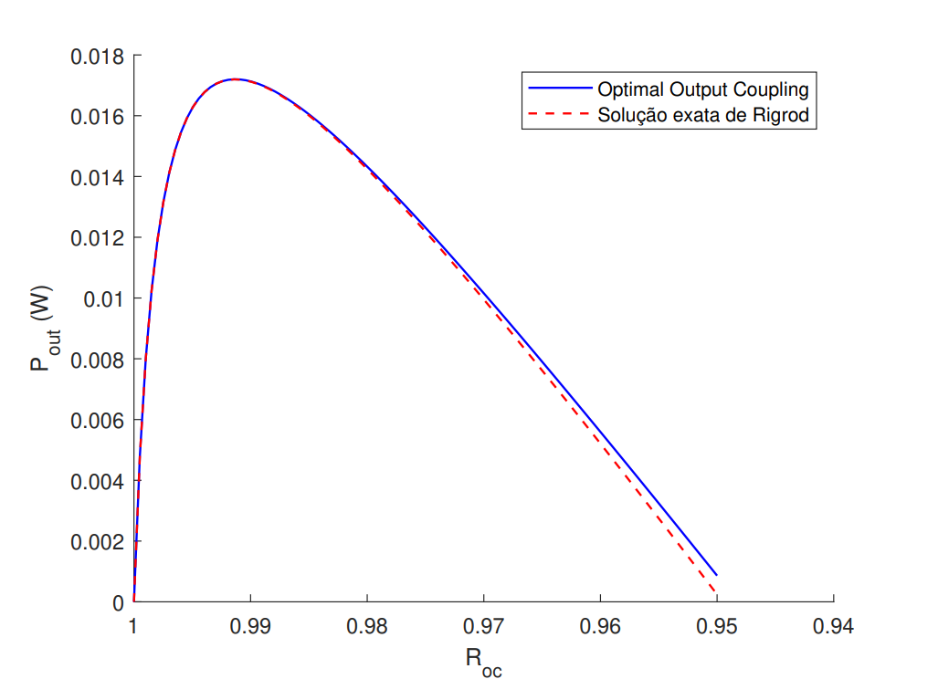
Calculation of the Output Power of a Laser
Rigrod analytical solution (low loss and low gain laser) :
Optimal Output Coupling ( Transmisson in R2, i.e, $T_{OC} < 10\%$) :

Slide 14

Conclusion
This work allow us to improve our team work and computational skills as well as helped us praticing writing na report with a scientific article template.
Helped us understant with higher detail how lasers work, what is Population Inversion and why does it happend.
Optimal Output Coupling can, in fact, simluate the value of 𝑃𝑜𝑢𝑡 (for$T_{OC}$< 10%), when comparing with the Rigrod analytical solution.
As the results obtained are as expected, when comparing with the results analyzed in the classes and discussed with the teachers, we can clonclued that the work was developed with succes.

Slide 15
References
[1] M.S. Csele. Laser Modeling: A Numerical Approach with Algebra and Calculus (1st ed.) 2014. url: https://doi.org/10.1201/b16770.
[2] Stimulated Emission in a Laser Cavity - Interactive
tutorial. url: https://micro.magnet.fsu.edu/primer/java/lasers/heliumneonlaser/
[3] Unacademy. "A brief note on coherent and incoherent sources”. 2022. url: https://unacademy.com/content/upsc/ study- material/ physics/ a - brief - note - on - coherent - and -incoherent- sources/
[4] Carlos Brites. Slides Teóricos Módulo 3 - Seminário de Engenharia Computacional (41020). 2022-23.
[5] O. Svelto and D.C. Hanna. "Principles of Lasers 4th edition". 1999. url: https://doi.org/10.1108/sr.1999.19.4.325.2.
[6] National Institute of Standards and Technology. "Nist guide to the si, appendix b.8: Factors for units listed alphabetically”. 2022. url: https://www.nist.gov/pml/special- publication- 811/nist- guidesi- appendix- b- conversion- factors/nist- guide- si- appendix- b8.
[7] M. Hackworth. Measuring Planck’s Constant. 2000. url: https : / / www. ifsc . usp . br / ~lavfis2 / BancoApostilasImagens / ApConstantePlanck/ApCtePlanck2013/planck’s.PDF.
[8] Toni. Scarmato. ’The speed of light in the quantum vacuum: the "Equation of God"’. 2022. url: https : / / www . researchgate . net /publication/366177760_The_speed_of_light_in_the_quantum_
vacuum_the_Equation_of_God/citations.
[9] MATLAB - ode15s.url: https://www.mathworks.com/help/matlab/ref/ode15s.html.
[10] W. W. Rigrod. “Saturation effects in high-gain lasers”. In: Journal of Applied Physics 36.8 (1965), pp. 2487–2490. doi:10.1063/1.1714517.
15

Slide 16
Thank you !

Slide 17
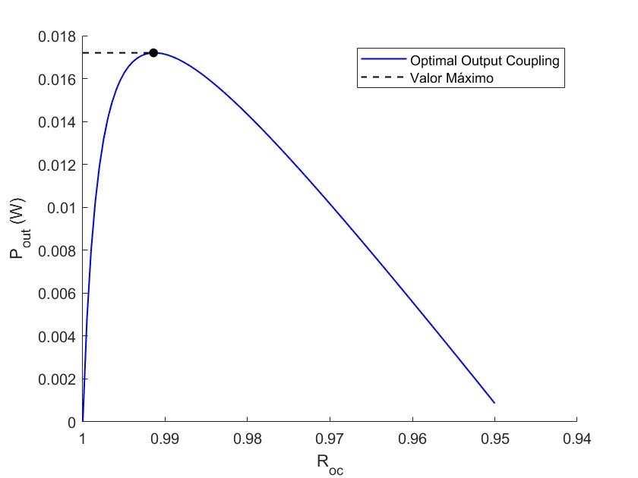
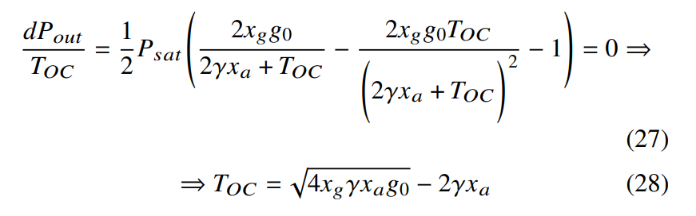


Maximize the $P_{Out}$
Optimal Output Coupling ( Transmisson in R2, i.e, $T_{OC} < 10\%$) :
Example Parameters for an He-Ne laser
From the formula: $T_{OC}≈0.87\%$
From the graphic : $T_{OC}≈0.86\%$
Notes:
A diferença entre os valores pode vir a partir do espaçamento usado entre os valores de TOC (0.05)

